Slide 1

Presentation to Education Subcommittee
Ways & Means
Heidi Sipe, Chair
Vickie Chamberlain, Executive Director
February 25, 2015

Slide 2


TSPC Mission
To establish, uphold and enforce professional standards of excellence and communicate those standards to the public and educators for the benefit of Oregon’s students.

Slide 3
Primary Functions
Set the standards for public school educator licensure;
Set the standards and perform site approval visits for Oregon educator licensure programs; and
Take disciplinary action against an educator’s license.

Slide 4

Agency Goals
1. Establish high standards for educator preparation excellence;
2. Provide leadership for professional licensure standards;
3. Provide timely high quality services;

Slide 5

TSPC Goals
4. Maintain and develop clear and concise administrative rules;
5. Establish high standards for educator professional conduct.

Slide 6
Historical Perspective
Oldest Professional Educator Standards Board;
First created in 1965;
Separate agency in 1973;
11 other Professional Educator Standards Boards;
17 commissioners (teachers, administrators, public);
3 executive directors;
Over 150,000 educators in data base;
Several hundred thousand more educators on microfilm.

Slide 7
Agency Organization

Slide 8
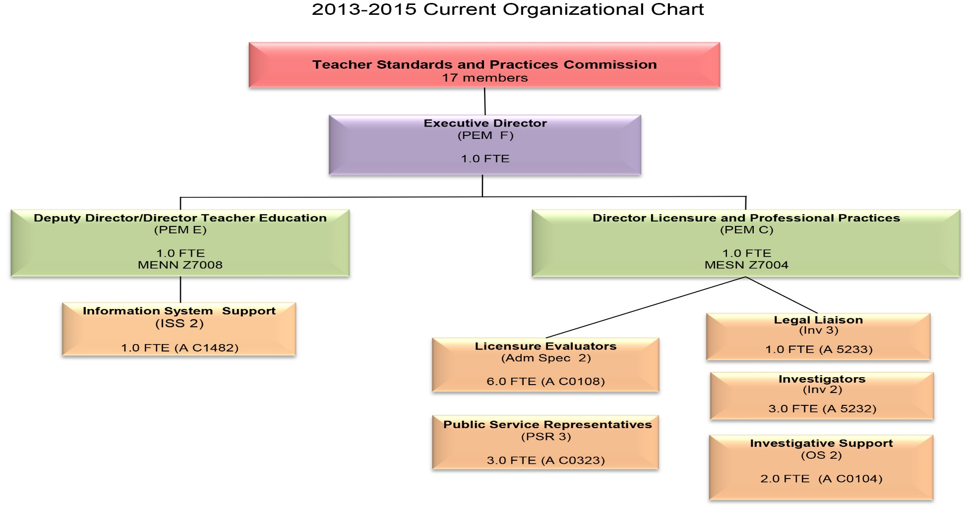
Agency Organization
2013-2015 (19 FTE)

Slide 9

TSPC has three program areas:
Licensure
Program Approval
Professional Practices

Slide 10
Licensure Program Summary

Slide 11
Licensure Program Summary
Approximately 59,800 licensed educators;
Holding about 64,000 licenses, registrations or certificates.
Clients Served:
Teachers, administrators, school counselors, librarians, school psychologists, school districts.

Slide 12
Types of Licenses Issued
(89% Teaching)

Slide 13
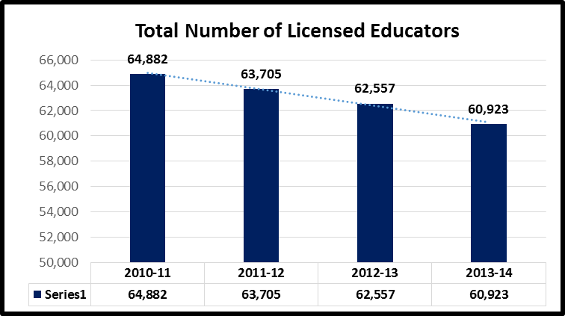
Drop in Total Licensed Educators

Slide 14
Licensure Volume
(Per Fiscal Year)

Slide 15
Employment
Licensed Teachers and Administrators in Oregon Public Schools (Does not includes School Counselors/Psychologists)
 | 10-11 | 11-12 | 12-13 | 13-14
Teachers (includes ESD) | 28,157 | 26,873 | 26,442 | 26,750
Administrators | 2,035 | 1,995 | 1,941 | 1967
Total Employed by Public Schools (FTE) | 30,192 | 28,868 | 28,383 | 28,717
Total Licensed by TSPC | 64,882 | 63,705 | 62,557 | 60,923
K-12 Students | 561,328 | 560,946 | 563,714 | 567,098

Slide 16
Program Approval Summary

Slide 17

Program Approval Policy Summary
  Clients Served:
Colleges;
Universities;
Candidates in programs;
School districts and ESDs.
  Enrollment in Teacher Preparation has dropped dramatically.

Slide 18
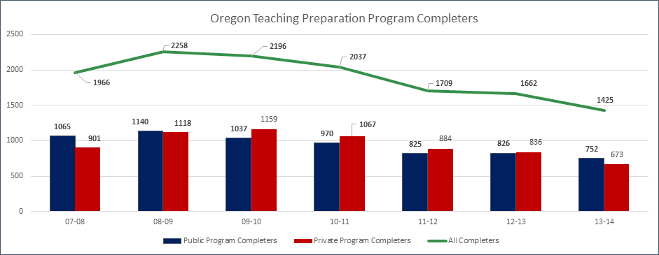
New Teacher Completers (Oregon Programs)

Slide 19
Licensure Program Approval Summary
Oregon Educator Preparation Programs (19 units)
Concordia University (Oregon) | Oregon State University
Concordia University/COSA (Chicago) | Pacific University
Corban University | Portland State University
Eastern Oregon University | Salem-Keizer (School Counseling)
George Fox University | Southern Oregon University
Lewis & Clark College | University of Oregon
Linfield College | University of Portland
Marylhurst University | Warner Pacific College
Multnomah University | Western Oregon University
Northwest Christian University

Slide 20
Number of Program Completers
*Willamette and University of Phoenix (Oregon) have closed their programs.

Slide 21
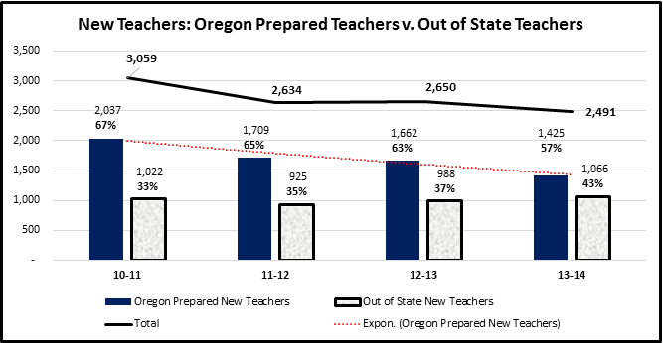
Oregon Prepared Teachers v. Out of State “New” Teachers

Slide 22
Program Approval
Calendar
State Approval of Programs Schedule
University (Unit) | Site Visit Date/Program Review Date
Portland State University (CAEP) | October 2015/Fall 2014
Western Oregon University (CAEP) | November 2015/Winter 2015
Northwest Christian University | Spring 2016/ Fall 2015
University of Oregon | Spring 2016 /Fall 2015
Southern Oregon University | Spring 2016/Fall 2015
Warner Pacific University | Winter 2017/ Spring 2016
Concordia University | Spring 2017/ Fall 2016

Slide 23
Professional Practices (Discipline) Summary

Slide 24

Professional Practices (Discipline) Summary

Slide 25
Professional Practices (Discipline) Summary
CLIENTS SERVED:
Investigated educators;
School districts and education service districts;
Charter schools;
Public.

Slide 26
Professional Practices (Discipline) Summary

Slide 27
Types of Discipline Actions
An educator’s violation of TSPC professional standards may result in:
Private reproval;
Reprimand;
Probation;
Suspension or revocation of the educator’s license(s); or
Suspension or revocation of educator’s right to apply for licensure.

Slide 28
Outcome of Cases (2014)

Slide 29
TSPC
Budget Environment

Slide 30
TSPC Revenue
TSPC is funded solely by licensure fees;
The current fee for initial and renewal of licenses is $100 per three or five year license ~ $33 or $20 per year respectively;
The $100 fee has been in place for 10 years – it was last raised from $75 in 2005.

Slide 31
Revenue and Positions
History

Slide 32
Cost Containment Measures
In response to the budget situation, the agency implemented the following cost containments measures:
Eliminated positions;
Continued to hold vacancies open;
Eliminated overtime;
Eliminated paper licenses (less mailing);
AG cost containment.

Slide 33
Effects of Declining Budget, Capped Fees, and Cost Containment Measures:
Email backlogs (KPM #1);
Licensure backlogs (KPM #2);
Investigation caseload backlogs (KPM #3);
Customer service rating declines (KPM #4);
Missed opportunities in field training and communications.

Slide 34
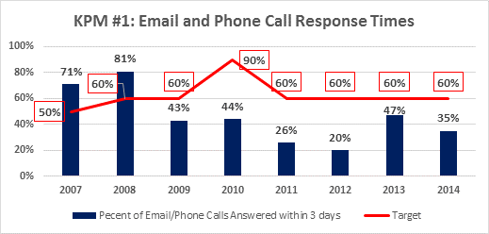
Email/Phone Call Backlogs:
Email/Phone Calls Responded to in 3 days (KPM #1)

Slide 35
Email/Phone Calls Responded to in 3 days (KPM #1)
Factors Affecting Performance:
Delays in issuing licenses (understaffed);
Employee lost time (illness/vacation).
Requested Changes to KPM #1:
Remove phone calls from performance measure;
Change target from 60% to 50%.

Slide 36
Licensure Backlog
Licensure application “turn-around” time February 15, 2013: 20 calendar days
(Four evaluators issued about 19,144 licenses annually)
Licensure application “turn-around” time February 15, 2015: 20 weeks
(Four evaluators issued about 17,611 licenses annually)

Slide 37
Licensure Backlog

Slide 38
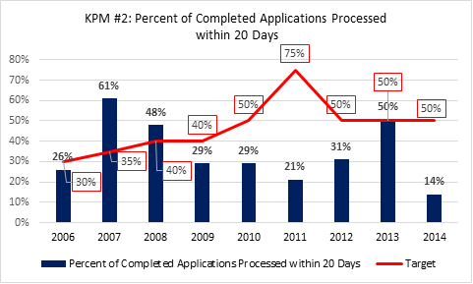
Completed Licensure Applications Processed
in 20 days (KPM #2)

Slide 39
Completed Licensure Applications Processed
in 20 days (KPM #2)
Factors Affecting Performance:
Too thinly staffed (leave/vacation/layoffs);
Staffing changes (lost direct supervision);
Staff pulled off to perform duties of other positions cut last biennium (mail, scan documents, data entry, phone backup, etc.).
No changes requested for KPM #2

Slide 40
Investigation Cases Backlog
Calendar Year | Investigations Completed | Complaints Received | Number of Investigators | Difference Between Investigations and Complaints
2008 | 257 | 252 | 3 | +5
2009 | 283 | 290 | 3 | -7
2010 | 278 | 268 | 3 | +10
2011 | 249 | 265 | 3 | -16
2012 | 227 | 291 | 3 | -64
2013 | 236 | 260 | 3 | -44
2014 | 132 | 259 | 3 | -127

Slide 41
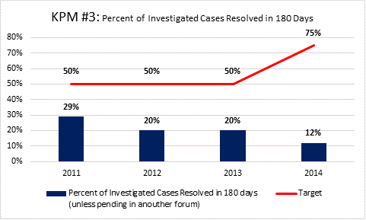
Investigation Backlog: Investigated Cases Resolved in 180 days (KPM #3)

Slide 42
Investigation Backlog: Investigated Cases Resolved in 180 days (KPM #3)
Factors Affecting Performance:
(Data prior to 2011 is not reliable)
Increase in reported cases;
Loss of investigator for nearly one year.
Requested changes to KPM #3:
Change to: Investigation Speed: Percent of complaints investigated within 270 days (9 months).

Slide 43
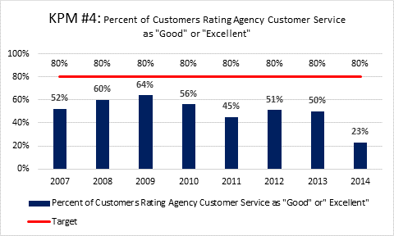
Customer Service: Percent of Customers Rating Agency Service as “Good” or “Excellent” (KPM #4)

Slide 44
Customers Rating their Overall Satisfaction with the Agency’s Customer Service as “Good” or “Excellent” (KPM #4)
Factors Affecting Performance
Slow licensure processing times;
Desire to reach “live body” on phone;
Slow response times to phone/email;
Staff turnover/lost time.
No changes requested for KPM #4

Slide 45

Time for Change
Streamline
Strengthen
Modernize

Slide 46
Commission Initiatives
During the 2013-15 biennium, the Commission began a strategic effort to streamline, strengthen and modernize the agency. The main components of this effort are:
  Modernizing by agency name change: Professional Educator Standards Board;
  Hiring one director for both licensure and professional practices;
  Developing an online licensing application system;
  Licensure redesign;
  Strengthening educator preparation programs;
  Streamlining professional practices area;
  Improving communications and field assistance.

Slide 47
Online Application System
Currently educators must pay for licenses through the mail by check;
Cumbersome process – opening mail, staff handling nearly $5 million in fees per biennium by hand.
New online application system:
  Apply for license online;
  Pay for license online;
  Check status of license application online;
  Eliminates need for manual processing.

Slide 48
Online Application System
Developed through NIC Systems under the umbrella of the DAS contract;
NIC has developed a similar system for the Hawaii professional educator standards board;
Cost of system will be paid for by $10 technology fee on licensure application;
Plan to have first phase operating in fall 2015.
Initiatives for 2015-17:
  Fully implement online system by January 1, 2016;
  Eliminate licensure backlog;
  Eliminate email backlog.

Slide 49
Licensure Redesign
Current Licensure Design:
Two Distinct Designs:
Licenses issued from 1965-1999:
  Basic; Standard.
Licenses issued from 1999 to present:
  Initial; Continuing.
Licensure Redesign Committee has been meeting for over two years to develop new tiered licensure structure.

Slide 50
Licensure Redesign
Proposed Licensure Redesign: HB 2411
All licenses in one system;
Teaching Licenses:
  Preliminary;
  Professional (Created by 2013 Legislature);
  Distinguished (Created by 2013 Legislature); and
  Legacy.
Initiatives for 2015-17:
  Redesign administrator license system;
  Redesign personnel license system;
  Redesign CTE licenses. The focus on CTE license redesign will be to help expand supply of CTE teachers.

Slide 51
Strengthening Oregon Teacher Preparation Programs
Increased rigor of approval standards;
Increased rigor of program reviews by state site teams;
Adopted edTPA (performance assessment) for new teacher candidates;
Initiatives for 2015-17:
    Increase training of program review teams;
    Federal Higher Education Act (Title II) requirements;
    Implementation of edTPA;
    Review and improve standards for administrator programs;
    Improving preparation in educator ethics;
    Improving training for supervisors of student teachers (stronger clinical practice).

Slide 52
Streamlining Professional Practices Area
Created a streamlined early review and disposition system for new cases;
Created plan for digitizing cases;
Initiatives for 2015-17:
  Eliminate backlog of cases;
  Complete all new investigations within 12 months;
  Create system for ethics training for current workforce;
  Start digitizing cases – eliminate need for off-site storage;
  Research case management software.

Slide 53
Improving Communications and Field Services
Communications and field services have not been able to be adequately addressed because of the agency’s current budget environment.
Initiatives for 2015-17 biennium:
  Restart newsletter;
  Provide technical assistance to districts;
  Provide technical assistance to preparation programs;
  Provide data to preparation programs to allow for the long-term tracking of their candidates.

Slide 54
Legislative Role

Slide 55
Agency Proposed Legislation
HB 2411:
New licensure design;
Name change (Professional Educator Standards Board);
Increase current fee caps.
HB 2412:
Housekeeping and minor policy changes.

Slide 56
TSPC 2015-17 Budget (GB)
Five Policy Packages:
Fee Increase (POP 101);
Licensure Backlog (POP 105);
Investigation Backlog (POP 102);
Program Approval Support (POP 104);
Administrative Support (POP 103).

Slide 57
Policy Package 101:
Fee Increase
Licensure Action | Current Fee | Proposed Fee
License Renewal | $100 | $140
New In-State Applications | $100 | $140
New Out-of-State Applications | $120 | $190
Charter School Registrations & Renewals | $75/$25 | $140
Fingerprints | $57 | $57
Convenience Fee (NIC) | $0 | $10

Slide 58
Policy Package 105: Licensure/Email Backlog
Reduce Email Backlog:
Add 1.0 FTE Public Service Representative (Limited Duration);
  Increase phone/email coverage.
Increase Staff Issuing Licenses:
Add 1.0 FTE Administrative Specialist 2 (Limited Duration);
  Issue more licenses.
  SUMMARY OF EXPENDITURES:
  Personal Services: $219,301
  Services and Supplies: $ 51,984
  Total: $271,285

Slide 59
Policy Package 102: Professional Practices Staff
Increase Professional Practices Staff :
Add 1.0 FTE Investigator 2 (Limited Duration);
  Reduce backlog.
Add 1.0 FTE Office Assistant 2 (Limited Duration)
  Reduce backlog.
SUMMARY OF EXPENDITURES:
Personal Services: $215,548
Services and Supplies: $ 48,588
Total: $264,136

Slide 60
Policy Package 104:
Program Approval Compliance
Add Support for Program Approval:
Add 1.0 FTE Compliance Specialist 2;
  Site visit support; federal compliance; edTPA implementation.
SUMMARY OF EXPENDITURES:
Personal Services: $143,199
Services and Supplies: $ 25,992
Total: $169,191

Slide 61
Policy Package 103: Executive Support
Executive Support:
Add 1 FTE Principal Executive Manager A;
  Budget, security plan, administrative rules, etc.
  SUMMARY OF EXPENDITURES:
  Personal Services: $141,294
  Services and Supplies: $ 25,992
  Total: $167,286

Slide 62
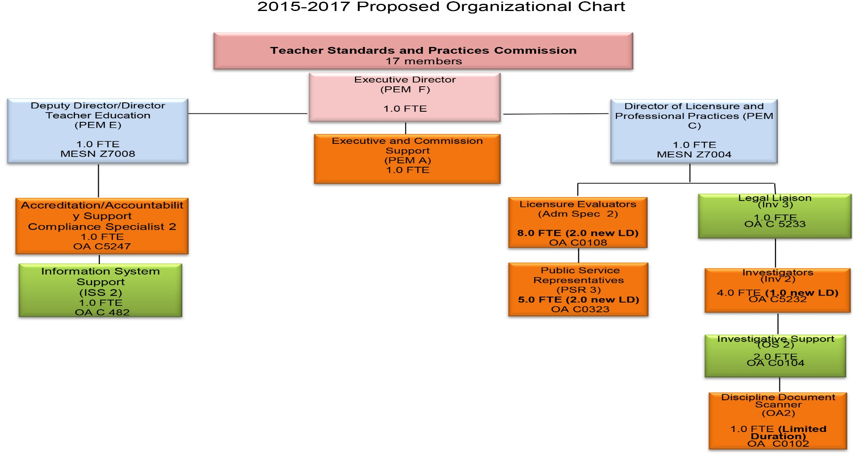
Agency Organization

Slide 63
Quantifying Results
(Deliverables)
Fee Increase (101)
  Agency will continue to post revenue gains and expenditures monthly and will continue to monitor revenues versus expenditures;
  The first six months of the biennium, there will not be a fee increase. Staff hired immediately.
Licensure Staffing (105) (Limited Duration)
  Issuing licenses within 20 days of receiving complete application by end of 2015-17 biennium;
  Reduce email backlog; Answer new email within three days of receipt.
Investigator Staffing (102) (Limited Duration)
  80 more cases per biennium;
  Reduction of case backlog. Reduction will depend on future growth of new cases.
Program Approval Staffing (104)
  Implementation of edTPA teacher candidate assessment;
  Review of administrator programs;
  Review and improvement of ethics training;
  Training of review team members;
  Development of training system for supervisors of student teachers (strengthening clinical practice);
  Collecting candidate data for preparation programs.
Executive Support (103)
  Security plan completed by April 2016;
  Restart the agency newsletter by January 1, 2016;
  Assist with ensuring the content on the agency web site is current (ongoing – part of implementation of new online application system);
  Complete timely evaluations of administrative staff annually.

